Slide 1
Weekly Update
Jorian Bruslind
Week 5

Slide 2
HyperRail Project
Current Status
Working with project stakeholders to integrate into site
NWREC (North Willamette Research and Extension Center)
On-campus greenhouses
Testing improved electronics
Verifying interoperability
Stress testing with loads
Slight improvements to mounting hardware
PETG upgrades for rain / UV resistance
Larger frame
Bell-Everman Servo Belt implementation

Slide 3
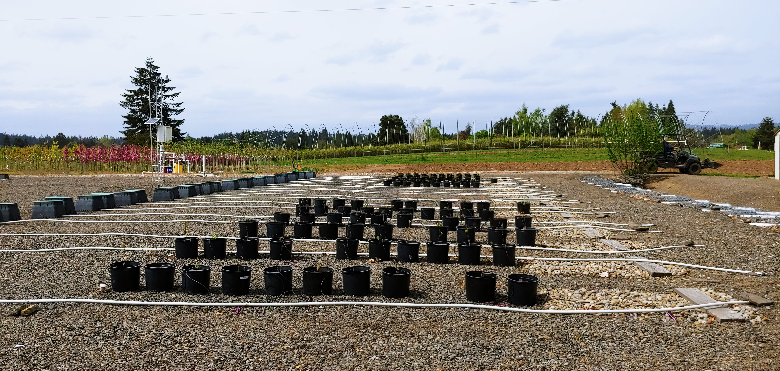
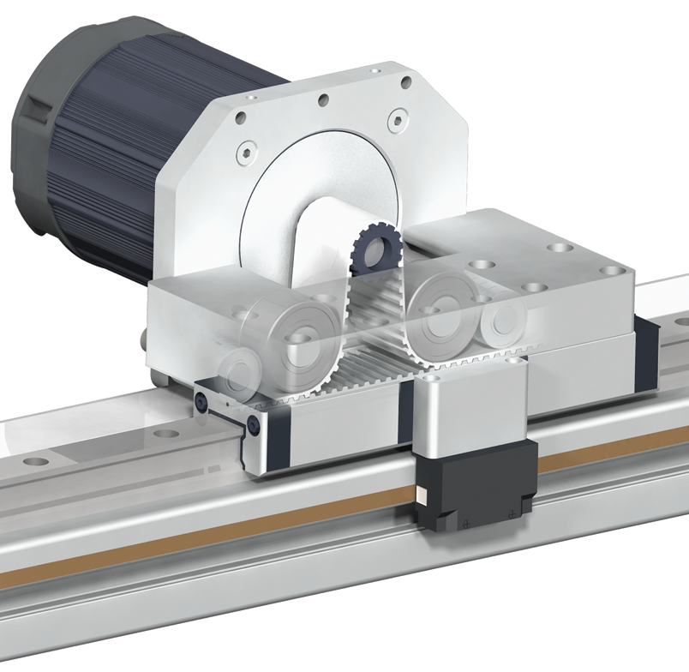
Current Status

Slide 4
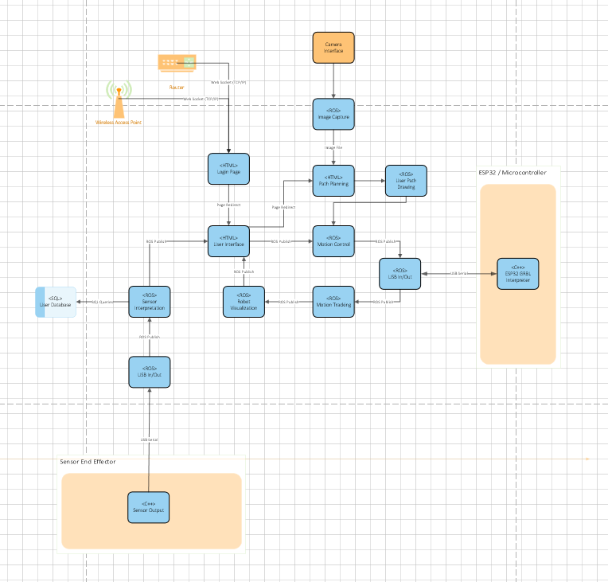
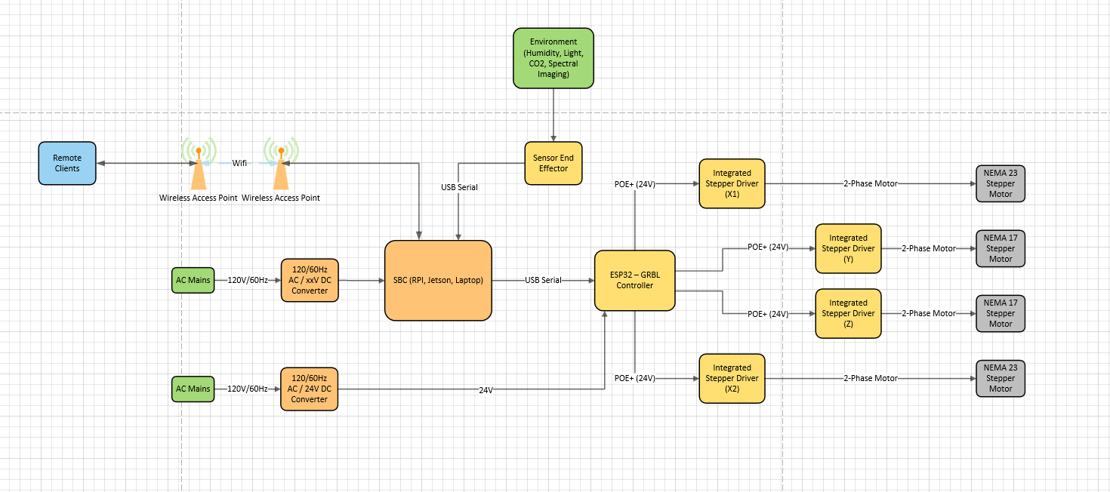
Project Work
System Block Diagram
Separate Hardware / Software Blocks (for now)

Slide 5
My Plan
Test design and check for any problems
Coordinated control
Automated control over USB / Wifi
Torque limit tests
Submit program of study
Upgrade Servo belt mechanism
Purchase new 8020 hardware for longer design

Slide 6
